Slide 1
Classification: Basic Concepts
Classification: Basic Concepts
Supervised Learning
Unsupervised Learning
Statistical Based Algorithm(Bayesian Classification Methods)
Distance Based Algorithm(K-Nearest Neighbor)
Decision Tree Based Algorithm
1
Notes:
1

Slide 2
Supervised vs. Unsupervised Learning
Supervised learning (classification)
Supervision: The training data (observations, measurements, etc.) are accompanied by labels indicating the class of the observations
New data is classified based on the training set
Unsupervised learning (clustering)
The class labels of training data is unknown
Given a set of measurements, observations, etc. with the aim of establishing the existence of classes or clusters in the data

Slide 3
Prediction Problems: Classification vs. Numeric Prediction
Classification
predicts categorical class labels (discrete or nominal)
classifies data (constructs a model) based on the training set and the values (class labels) in a classifying attribute and uses it in classifying new data
Numeric Prediction
models continuous-valued functions, i.e., predicts unknown or missing values
Typical applications
Credit/loan approval
Medical diagnosis: if a tumor is cancerous or benign
Fraud detection: if a transaction is fraudulent
Web page categorization: which category it is

Slide 4
Classification—A Two-Step Process
Model construction: describing a set of predetermined classes
Each tuple/sample is assumed to belong to a predefined class, as determined by the class label attribute
The set of tuples used for model construction is training set
The model is represented as classification rules, decision trees, or mathematical formulae
Model usage: for classifying future or unknown objects
Estimate accuracy of the model
The known label of test sample is compared with the classified result from the model
Accuracy rate is the percentage of test set samples that are correctly classified by the model
Test set is independent of training set (otherwise overfitting)
If the accuracy is acceptable, use the model to classify new data
Note: If the test set is used to select models, it is called validation (test) set

Slide 5
Process (1): Model Construction
Classification
Algorithms
Training
Data
Classifier
(Model)
IF rank = ‘professor’
OR years > 6
THEN tenured = ‘yes’

Slide 6
Process (2): Using the Model in Prediction
Classifier
Testing
Data
Unseen Data
(Jeff, Professor, 4)
Tenured?

Slide 7
Bayesian Classification
A statistical classifier: performs probabilistic prediction, i.e., predicts class membership probabilities
Foundation: Based on Bayes’ Theorem.
Performance: A simple Bayesian classifier, naïve Bayesian classifier, has comparable performance with decision tree and selected neural network classifiers
Incremental: Each training example can incrementally increase/decrease the probability that a hypothesis is correct — prior knowledge can be combined with observed data
Standard: Even when Bayesian methods are computationally intractable, they can provide a standard of optimal decision making against which other methods can be measured

Slide 8
Bayesian Classification
Bayesian classifier can predict the probability that a given tuple belongs to a particular class.
It is based on Bayes’ theorem.
Bayesian classifier gives more speed and accuracy as compared to Decision tree classifier.
First we recall the Bayes’ theorem in probability then we will understand the working of Bayesian classification method.

Slide 9
Bayes’ theorem:
Let X be a data tuple which is described by measurements made on a set of n attributes.
[Note : In Bayesian term X is also called evidence]
Let H be some hypothesis.
We assume the hypothesis H: the data tuple X belongs to a specified class C.
Then, for classification problems, we have to find P(H/X) i.e. the probability of hypothesis H when X is given.

Slide 10
Bayes’ theorem:
Example: Suppose we have employee database consists of several attributes like department, age and salary, etc.
And status is the class label attribute which is either senior or junior.
Let X is the detail of an employee. i.e. X=( department= sales, age= 35, salary=40K)
Let the Hypothesis H: employee belongs to senior class.
Then we can defined prior and posterior probability as follows:

Slide 11
Bayes’ theorem:
[1] Posterior probability:
P(H/X) is the probability that the employee X will belongs to senior class given that we know the employee’s department, age and salary.
P(X/H) is the probability that an employee, X, is of sales department, with age 35 and have salary 40K, given that, it belongs to senior class.
[2] Prior probability:
P(H) is the probability that any given employee will belong to the senior class regardless of any information like department , age etc.

Slide 12
Bayes’ theorem:
P(X) is the probability of an employee whose age is 35 years, department is sales and the salary is 40K.
The posterior probability can be calculated using Bayes’ theorem as:

Slide 13
Naïve Bayes Classifier: Training Dataset
Training Data set:
Class:
C1:buys_computer = ‘yes’
C2:buys_computer = ‘no’
Data is to be classified(Target Data):
X = (age=youth,
Income = medium,
Student = yes
Credit_rating = Fair)

Slide 14
Bayes’ Theorem: Basics
Let X(age=youth, income = medium, student = yes, credit_rating = fair) be a data sample (“evidence”): class label is unknown
Let H be a hypothesis that X belongs to class C1:(buys_computer=yes) or C2(buys_computer= no)
Now compute posterior probabilities: P(buys_comuter=yes|X)
and
P(buys_comuter=no|X)
Compare the both probability and target data X will belong to class (hypothesis) with greater probability one (maximize).
Note here we need not to compute P(X) because it is common in both case only need to compute P(X|H).P(H) in both cases for comparison

Slide 15
Bayes’ Theorem: Basics
Bayes’ Theorem:
Let X(age=youth, income = medium, student = yes, credit_rating = fair) be a data sample (“evidence”): class label is unknown
Let H be a hypothesis that X belongs to class C1(buys_computer=yes) or C2(buys_computer= no)
Now compute: P(buys_comuter=yes|X) and
P(buys_comuter=no|X)
by above probability function and compare the both probability , target data X will belong to class (hypothesis) with greater probability .
Note here we need not to compute P(X) because it is common in both case only need to compute P(X|H).P(H) in both cases for comparison

Slide 16
Classification Is to Derive the Maximum Posteriori
Let D be a training set of tuples and their associated class labels, and each tuple is represented by an n-D attribute vector X = (x₁, x₂, …, x_{n})
Suppose there are m classes C₁, C₂, …, C_{m}.
Classification is to derive the maximum posteriori, i.e., the maximal P(C_{i}|X)
This can be derived from Bayes’ theorem for i=1 to m (no. of classes)
Since P(X) is constant for all classes hence need not calculate, hence target data X belongs to Class C_{i} if and only if for all j!=i.
i.e

Slide 17
Naïve Bayes Classifier
A simplified assumption: attributes are conditionally independent (i.e., no dependence relation between attributes):

Slide 18
Naïve Bayes Classifier: Training Dataset
Class:
C1:buys_computer = ‘yes’
C2:buys_computer = ‘no’
Data to be classified:
X = (youth,
Income = medium,
Student = yes
Credit_rating = Fair)

Slide 19
Naïve Bayes Classifier: An Example
P(C_{i}): P(buys_computer = “yes”) = 9/14 = 0.643
P(buys_computer = “no”) = 5/14= 0.357
Compute P(X|C_{i}) for each class
P(age = “youth” | buys_computer = “yes”) = 2/9 = 0.222
P(age = “youth” | buys_computer = “no”) = 3/5 = 0.6
P(income = “medium” | buys_computer = “yes”) = 4/9 = 0.444
P(income = “medium” | buys_computer = “no”) = 2/5 = 0.4
P(student = “yes” | buys_computer = “yes) = 6/9 = 0.667
P(student = “yes” | buys_computer = “no”) = 1/5 = 0.2
P(credit_rating = “fair” | buys_computer = “yes”) = 6/9 = 0.667
P(credit_rating = “fair” | buys_computer = “no”) = 2/5 = 0.4

Slide 20
Naïve Bayes Classifier: An Example
X = (age = youth , income = medium, student = yes, credit_rating = fair)
P(X|C_{i}) :
P(X|buys_computer = “yes”) = 0.222 x 0.444 x 0.667 x 0.667 = 0.044
P(X|buys_computer = “no”) = 0.6 x 0.4 x 0.2 x 0.4 = 0.019
P(X|C_{i})*P(C_{i}) :
P(X|buys_computer = “yes”) * P(buys_computer = “yes”) =0.044*0.643 = 0.028
P(X|buys_computer = “no”) * P(buys_computer = “no”) = 0.019* 0.357= 0.007
Therefore, X = (age = youth , income = medium, student = yes, credit_rating = fair)
belongs to class (“buys_computer = yes”)

Slide 21
Naïve Bayes Classifier: An Example
Therefore,
X = (age = middle , income = high, student = no, credit_rating = excellent)
Class of x is buys_computer =yes

Slide 22
Naïve Bayes Classifier: Comments
Advantages
Easy to implement
Good results obtained in most of the cases
Disadvantages
Assumption: class conditional independence, therefore loss of accuracy
Practically, dependencies exist among variables
E.g., hospitals: patients: Profile: age, family history, etc.
Symptoms: fever, cough etc., Disease: lung cancer, diabetes, etc.
Dependencies among these cannot be modeled by Naïve Bayes Classifier

Slide 23
INSTANCE-BASED LEARNING

Slide 24
INSTANCE-BASED LEARNING
It is also known as memory-based learning or lazy-learning (because they delay processing until a new instance must be classified).
It is a family of learning algorithms that, instead of performing explicit generalization, compares new problem instances with instances seen in training.
It is an integral part of Machine Learning, used to classify new instances based on a similarity measure.
The time complexity of this algorithm depends upon the size of training data. The worst-case time complexity of this algorithm is O (n), where n is the number of training instances.
Each time whenever a new query is encountered, its previously stores data is examined.
And assign to a target function value for the new instance.

Slide 25
INSTANCE-BASED LEARNING
Advantages:
Instead of estimating for the entire instance set, local approximations can be made to the target function.
This algorithm can adapt to new data easily, one which is collected as we go .
Disadvantages:
Classification costs are high
Large amount of memory required to store the data, and each query involves starting the identification of a local model from scratch.
Some of the instance-based learning algorithms are :
K Nearest Neighbor (KNN)
Self-Organizing Map (SOM)
Learning Vector Quantization (LVQ)
Locally Weighted Learning (LWL)
Case-Based Reasoning

Slide 26
INSTANCE-BASED LEARNING
Simplest form of learning: rote learning
Training instances are searched for instance that most closely resembles new instance
The instances themselves represent the knowledge
Also called instance-based learning
The similarity function defines what is “learned”
Instance-based learning is lazy learning
Methods: nearest-neighbour, k-nearest-neighbour.

Slide 27
INSTANCE-BASED LEARNING
Distance Function:
Simplest case: one numeric (continuous) attribute
Distance is the difference between the two attribute values involved (or a function thereof)
Several numeric attributes: normally, Euclidean distance is used and attributes are normalized
Nominal (discrete) attributes: distance is set to 1 if values are different, 0 if they are equal
Generalised distance functions: can use discrete and continuous attributes
Are all attributes equally important?
Weighting the attributes might be necessary

Slide 28
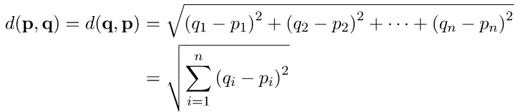
Euclidean Distance
Euclidean distance is considered the traditional metric for problems with geometry.
It can be simply explained as the ordinary distance between two points.
It is one of the most used algorithms in the cluster analysis.
One of the algorithms that use this formula would be K-mean.
Mathematically it computes the root of squared differences between the coordinates between two objects.

Slide 29
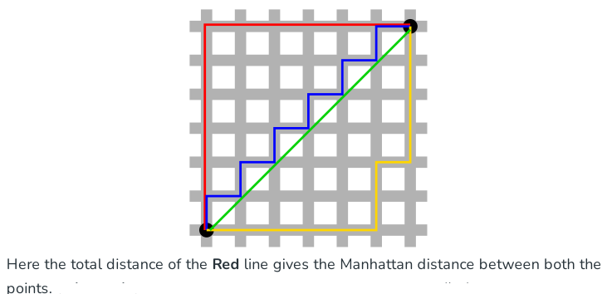
Manhattan Distance:
This determines the absolute difference among the pair of the coordinates.
Suppose we have two points P and Q to determine the distance between these points we simply have to calculate the perpendicular distance of the points from X-Axis and Y-Axis.
In a plane with P at coordinate (x1, y1) and Q at (x2, y2). Manhattan distance between P and Q = |x1 – x2| + |y1 – y2|

Slide 30
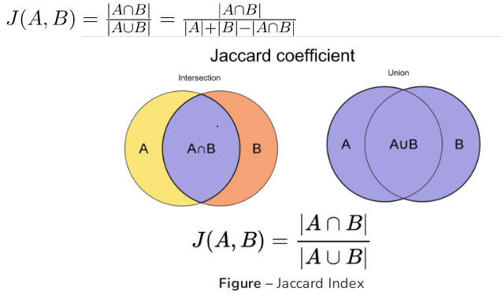
Jaccard Index:
The Jaccard distance measures the similarity of the two data set items as the intersection of those items divided by the union of the data items.

Slide 31
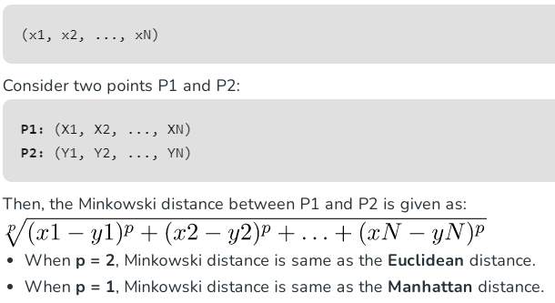
Minkowski distance:
It is the generalized form of the Euclidean and Manhattan Distance Measure. In an N-dimensional space, a point is represented as,

Slide 32
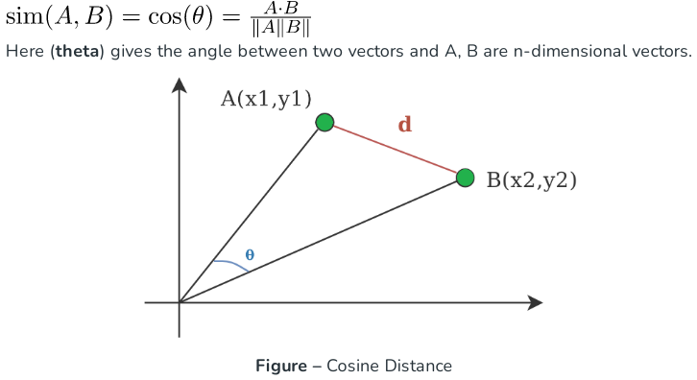
Cosine Index::
Cosine distance measure for clustering determines the cosine of the angle between two vectors given by the following formula.

Slide 33
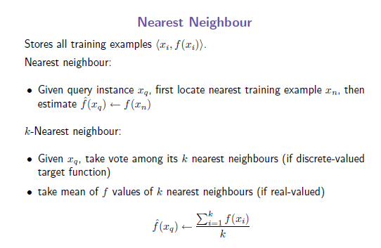
INSTANCE-BASED LEARNING

Slide 34
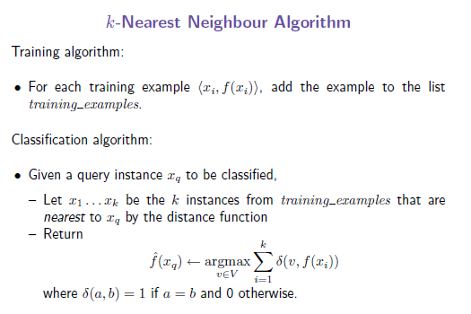
INSTANCE-BASED LEARNING

Slide 35
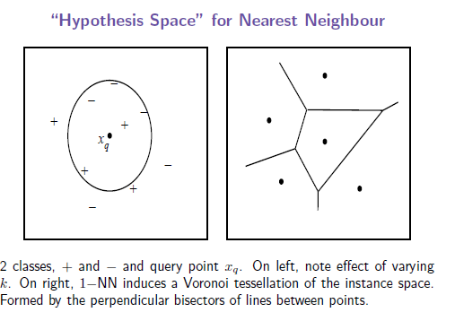
INSTANCE-BASED LEARNING

Slide 36
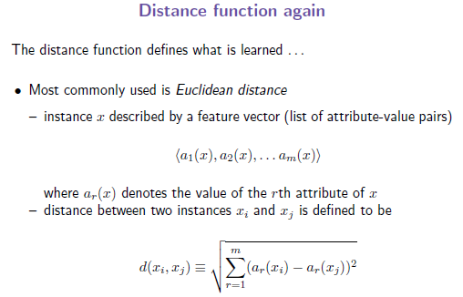
INSTANCE-BASED LEARNING

Slide 37
INSTANCE-BASED LEARNING
• Many other distances, e.g. Manhattan or city-block (sum of absolute
values of differences)

Slide 38
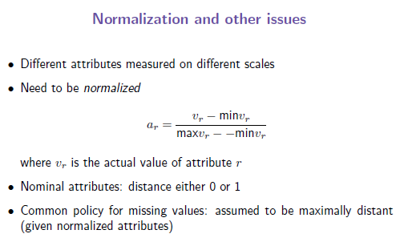
INSTANCE-BASED LEARNING

Slide 39
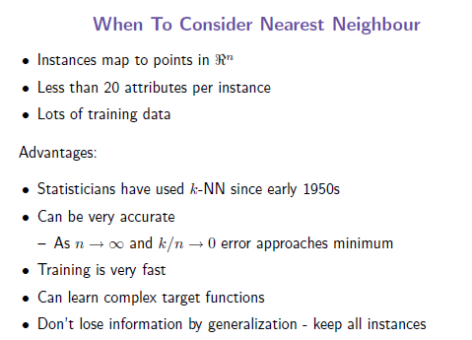
INSTANCE-BASED LEARNING

Slide 40
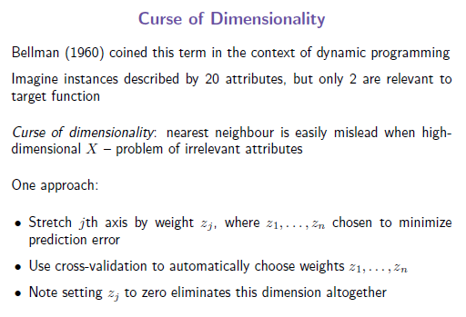
INSTANCE-BASED LEARNING

Slide 41
INSTANCE-BASED LEARNING

Slide 42
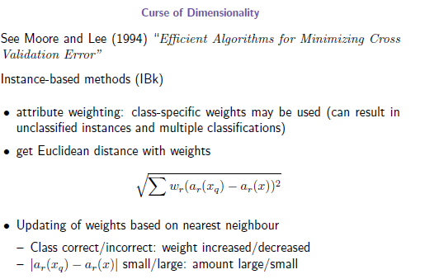
INSTANCE-BASED LEARNING

Slide 43
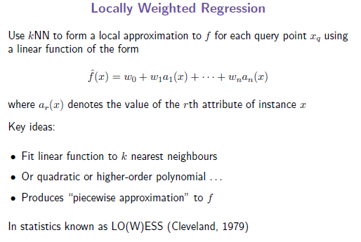
INSTANCE-BASED LEARNING

Slide 44
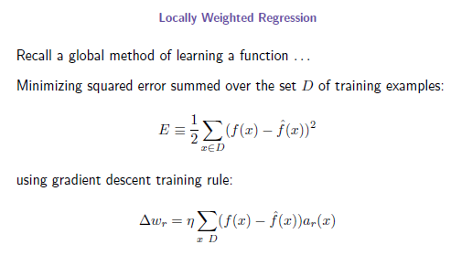
INSTANCE-BASED LEARNING

Slide 45

Radial basis function (RBF)
In a mathematical context, RBF is a real-valued function that we use to calculate the distance between two points.
RBF networks are an artificial neural network (ANN) type that uses the radial basis function as its activation function.
RBF networks commonly use for function approximation, classification, time series prediction, and clustering tasks.
RBF measures the similarity between a given data point and an agreed reference point.
This similarity score can then use to take specific actions, such as activating a dead neural network node.
Mathematical Definition of Radial Basis Function is:
where x, x’ are vector points in any fixed dimensional space.

Slide 46
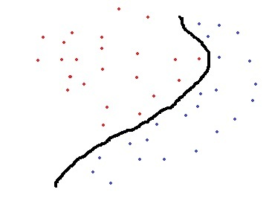
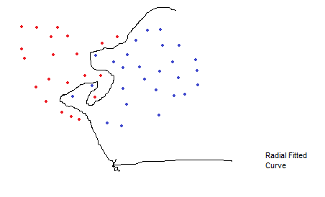
Radial basis function (RBF)
Why Radial Basis Kernel Is much powerful?
The main motive of the kernel is to calculations in any d-dimensional space where d > 1, so that we can get a quadratic, cubic or any polynomial equation of large degree for our classification/regression line.
Since Radial basis kernel uses exponent and as we know the expansion of e^x gives a polynomial equation of infinite power, so using this kernel, we make our regression/classification line infinitely powerful too. Some Complex Dataset Fitted Using RBF Kernel easily:

Slide 47
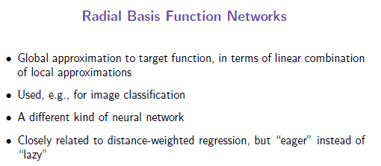
INSTANCE-BASED LEARNING

Slide 48
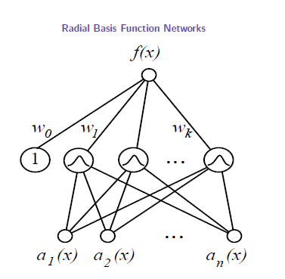
INSTANCE-BASED LEARNING
An RBF model comprises of three layers including:
1. An input layer
2. A hidden layer with a nonlinear RBF activation function
3. A linear output layer

Slide 49
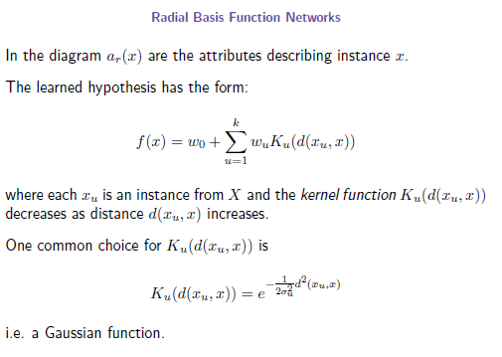
INSTANCE-BASED LEARNING

Slide 50
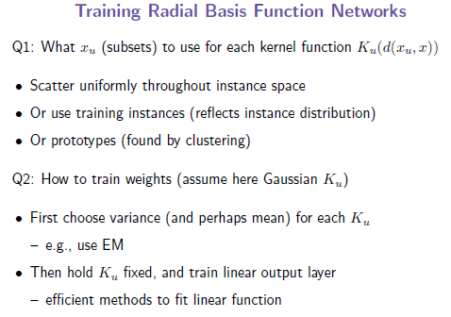
INSTANCE-BASED LEARNING

Slide 51
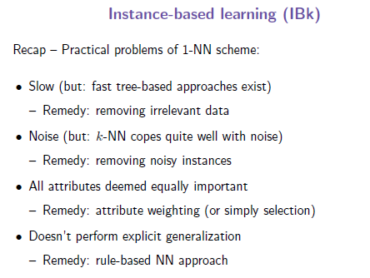
INSTANCE-BASED LEARNING

Slide 52
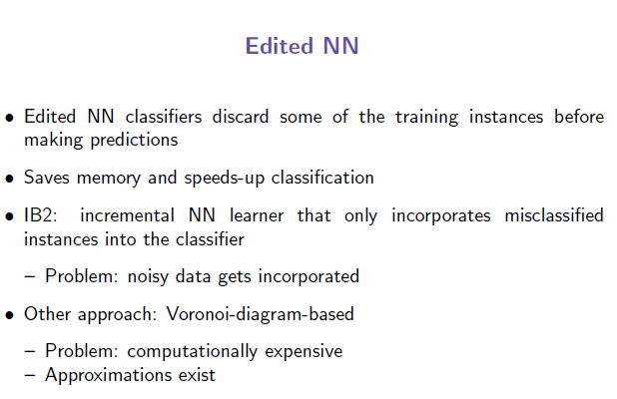
INSTANCE-BASED LEARNING

Slide 53
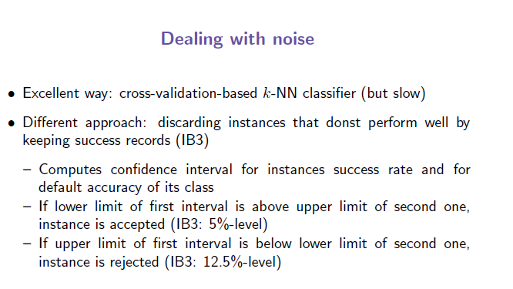
INSTANCE-BASED LEARNING

Slide 54
Case Based Reasoning (CBR) Classifier
Instance-based methods such as k-NEAREST NEIGHBOR and locally weighted regression share three key properties.
First, they are lazy learning methods in that they defer the decision of how to generalize beyond the training data until a new query instance is observed.
Second, they classify new query instances by analyzing similar instances while ignoring instances that are very different from the query.
Third, they represent instances as real-valued points in an n-dimensional Euclidean space.
Case-based reasoning (CBR) is a learning paradigm based on the first two of these principles, but not the third.

Slide 55
Case Based Reasoning (CBR) Classifier
In CBR, instances are typically represented using more rich symbolic descriptions, and the methods used to retrieve similar instances are correspondingly more elaborate.
CBR has been applied to problems such as conceptual design of mechanical devices based on:
A stored library of previous designs.
Reasoning about new legal cases based on previous rulings
Solving planning and scheduling problems by reusing and combining portions of previous solutions to similar problems.

Slide 56
Case Based Reasoning (CBR) Classifier
As we know Nearest Neighbour classifiers stores training tuples as points in Euclidean space.
But Case-Based Reasoning classifiers (CBR) use a database of problem solutions to solve new problems.
It stores the tuples or cases for problem-solving as complex symbolic descriptions.
How CBR works?
When a new case arises to classify, a Case-based Reasoner(CBR) will first check if an identical training case exists.
If one is found, then the accompanying solution to that case is returned.
If no identical case is found, then the CBR will search for training cases having components that are similar to those of the new case.

Slide 57
Case Based Reasoning (CBR) Classifier
Conceptually, these training cases may be considered as neighbours of the new case.
If cases are represented as graphs, this involves searching for subgraphs that are similar to subgraphs within the new case.
The CBR tries to combine the solutions of the neighbouring training cases to propose a solution for the new case.
If compatibilities arise with the individual solutions, then backtracking to search for other solutions may be necessary.
The CBR may employ background knowledge and problem-solving strategies to propose a feasible solution.

Slide 58
Case Based Reasoning (CBR) Classifier
Applications of CBR includes:
Problem resolution for customer service help desks, where cases describe product-related diagnostic problems.
It is also applied to areas such as engineering and law, where cases are either technical designs or legal rulings, respectively.
Medical educations, where patient case histories and treatments are used to help diagnose and treat new patients.
Challenges with CBR
Finding a good similarity metric (eg for matching subgraphs) and suitable methods for combining solutions.
Selecting salient features for indexing training cases and the development of efficient indexing techniques.

Slide 59
Case Based Reasoning (CBR) Classifier
CBR becomes more intelligent as the number of the trade-off between accuracy and efficiency evolves as the number of stored cases becomes very large.
But after a certain point, the system’s efficiency will suffer as the time required to search for and process relevant cases increases.

Slide 60
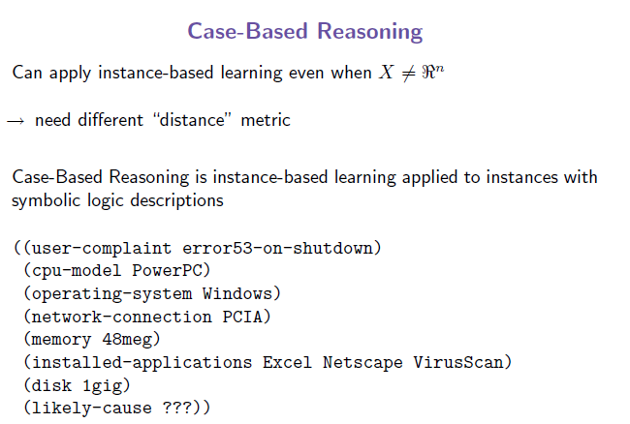
Case Based Reasoning (CBR) Classifier

Slide 61
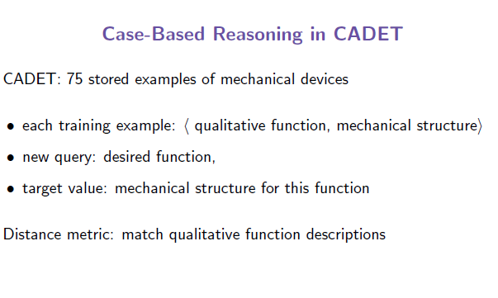
Case Based Reasoning (CBR) Classifier

Slide 62
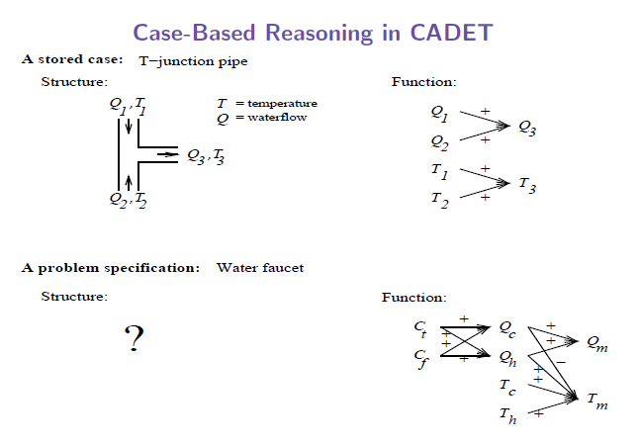
Case Based Reasoning (CBR) Classifier
CADET is a Case-based Design Tool. CADET is a system that aids conceptual design of electro-mechanical devices and is based on the paradigm of Case-based Reasoning.

Slide 63
Case Based Reasoning (CBR) Classifier
Let us consider a prototypical example of a case-based reasoning system to ground our discussion.
The CADET system employs case based reasoning to assist in the conceptual design of simple mechanical devices such as water faucets.
It uses a library containing approximately 75 previous designs and design fragments to suggest conceptual designs to meet the specifications of new design problems. Each instance stored in memory (e.g., a waterpipe) is represented by describing both its structure and its qualitative function.
New design problems are then presented by specifying the desired function and requesting the corresponding structure
The top half of the figure shows the description of a typical stored case called a T-junction pipe.
Its function is represented in terms of the qualitative relationships among the water flow levels and temperatures at its inputs and outputs.
In the functional description at its right, an arrow with a "+" label indicates that the variable at the arrowhead increases with the variable at its tail.
For example, the output water flow Q3 increases with increasing input water flow Ql.

Slide 64
Case Based Reasoning (CBR) Classifier
Similarly a "-" label indicates that the variable at the head decreases with the variable at the tail.
The bottom half of this figure depicts a new design problem described by its desired function.
This particular function describes the required behaviour of one type of water faucet.
Here Q_{c} refers to the flow of cold water into the faucet, Q_{h} to the input flow of hot water, and Q_{m}, to the single mixed flow out of the faucet.
Similarly T_{c} , T_{h} and T_{m} refer to the temperatures of the cold water, hot water, and mixed water respectively.
The variable C_{t} denotes the control signal for temperature that is input to the faucet, and C_{f} denotes the control signal for water flow.
Note the description of the desired function specifies that these controls C_{t} , and C_{f} are to influence the water flows Q_{c} and Q_{h ,} thereby indirectly influencing the faucet output flow Q_{m} , and temperature T_{m} .

Slide 65
Case Based Reasoning (CBR) Classifier
Given this functional specification for the new design problem, CADET searches its library for stored cases whose functional descriptions match the design problem.
If an exact match is found, indicating that some stored case implements exactly the desired function, then this case can be returned as a suggested solution to the design problem.
If no exact match occurs, CADET may find cases that match various subgraphs of the desired functional specification.
In Figure , for example, the T-junction function matches a subgraphs of the water faucet function graph.
More generally, CADET searches for subgraphs isomorphism between the two function graphs, so that parts of a case can be found to match parts of the design specification.
Furthermore, the system may elaborate the original function specification graph in order to create functionally equivalent graphs that may match still more cases.
It uses general knowledge about physical influences to create these elaborated function graphs.

Slide 66
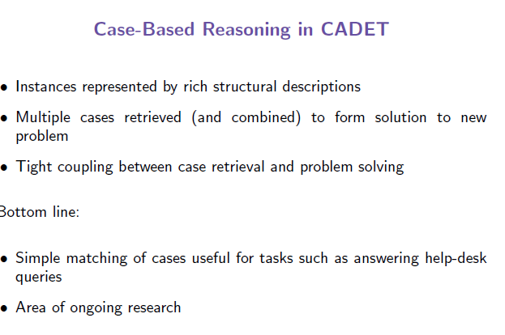
Case Based Reasoning (CBR) Classifier

Slide 67
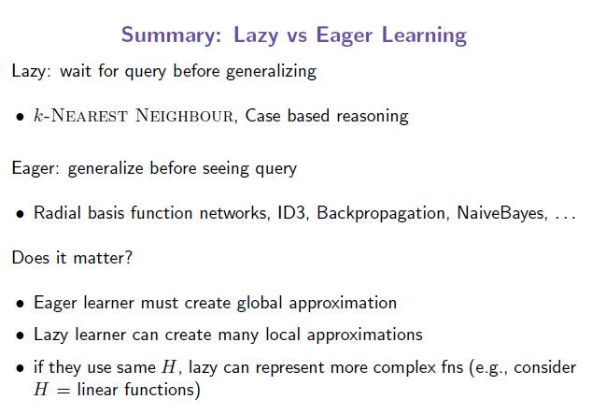
Case Based Reasoning (CBR) Classifier

Slide 68
Introduction to K-Nearest Neighbor (KNN)
KNN is a non-parametric supervised learning technique in which we try to classify the data point to a given category with the help of training set.
In simple words, it captures information of all training data set and classifies new target data based on a similarity.
Predictions are made for a new instance (x) by searching through the entire training set for the K most similar cases (neighbors) and summarizing the output variable for those K cases.
In classification this is the mode (or most common) class value.

Slide 69
How KNN algorithm works
Suppose we have height, weight and T-shirt size of some customers.
We need to predict the T-shirt size of a new customer given only height and weight information we have.
Data including height, weight and T-shirt size information is shown below –
New customer named 'Monica' has height 161cm and weight 61kg. KNN can be used to predict the desired T-shirt size

Slide 70
Height (in cms) | Weight (in kgs) | T Shirt Size
158 | 58 | M
158 | 59 | M
158 | 63 | M
160 | 59 | M
160 | 60 | M
163 | 60 | M
163 | 61 | M
160 | 64 | L
163 | 64 | L
165 | 61 | L
165 | 62 | L
165 | 65 | L
168 | 62 | L
168 | 63 | L
168 | 66 | L
170 | 63 | L
170 | 64 | L
170 | 68 | L

Slide 71
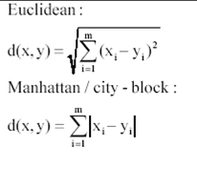
Step 1 : Calculate Similarity based on distance function
There are many distance functions but Euclidean is the most commonly used measure. It is mainly used when data is continuous.
Manhattan distance is also very common for continuous variables.

Slide 72
Height X (in cms) | Weight Y (in kgs) | T Shirt Size (class Label) | Distance(X,Y) to (161, 61)
158 | 58 | M | 4.24
158 | 59 | M | 3.61
158 | 63 | M | 3.61
160 | 59 | M | 2.24
160 | 60 | M | 1.41
163 | 60 | M | 2.24
163 | 61 | M | 2.00
160 | 64 | L | 3.16
163 | 64 | L | 3.61
165 | 61 | L | 4.00
165 | 62 | L | 4.12
165 | 65 | L | 5.66
168 | 62 | L | 7.07
168 | 63 | L | 7.28
168 | 66 | L | 8.60
170 | 63 | L | 9.22
170 | 64 | L | 9.49
170 | 68 | L | 11.40

Slide 73
Let K=7 arrange table in increasing order by distance. Here class labels are[M,M,M,M,L,M,M]. Majority is M hence target data(161,61) will be in class M. Similarly we can check for any K
Height X (in cms) | Weight Y (in kgs) | T Shirt Size (class Label) | Distance(X,Y) to (161,61)
160 | 60 | M | 1.41
163 | 61 | M | 2.00
160 | 59 | M | 2.24
163 | 60 | M | 2.24
160 | 64 | L | 3.16
158 | 59 | M | 3.61
158 | 63 | M | 3.61
163 | 64 | L | 3.61
165 | 61 | L | 4.00
165 | 62 | L | 4.12
158 | 58 | M | 4.24
165 | 65 | L | 5.66
168 | 62 | L | 7.07
168 | 63 | L | 7.28
168 | 66 | L | 8.60
170 | 63 | L | 9.22
170 | 64 | L | 9.49
170 | 68 | L | 11.40

Slide 74
Let K=15 arrange table in increasing order by distance. Here class labels are[M,M,M,M,L,M,M,L,L,L,M,L,L,L,L]. Majority is L hence target data(161,61) will be in class l.
Height X (in cms) | Weight Y (in kgs) | T Shirt Size (class Label) | Distance(X,Y) to (161,61)
160 | 60 | M | 1.41
163 | 61 | M | 2.00
160 | 59 | M | 2.24
163 | 60 | M | 2.24
160 | 64 | L | 3.16
158 | 59 | M | 3.61
158 | 63 | M | 3.61
163 | 64 | L | 3.61
165 | 61 | L | 4.00
165 | 62 | L | 4.12
158 | 58 | M | 4.24
165 | 65 | L | 5.66
168 | 62 | L | 7.07
168 | 63 | L | 7.28
168 | 66 | L | 8.60
170 | 63 | L | 9.22
170 | 64 | L | 9.49
170 | 68 | L | 11.40

Slide 75
Pros and Cons of KNN
Pros
Easy to understand
No assumptions about data
Can be applied to both classification and regression
Works easily on multi-class problems
Cons
Memory Intensive / Computationally expensive
Sensitive to scale of data
Not work well on rare event (skewed) target variable
Struggle when high number of independent variables

Slide 76
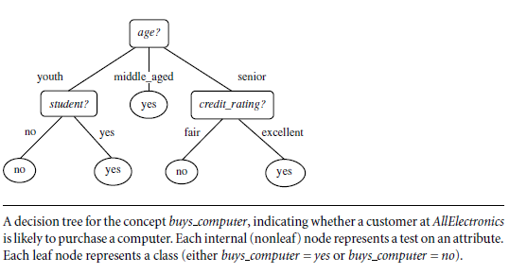
Decision Tree Induction:
Class:C1:buys_computer = ‘yes’
C2:buys_computer = ‘no’
Data to be classified: X = (age=youth, Income = medium, Student = yes, Credit_rating = Fair)
Two Steps:
Construct Decision Tree from training Data set
Predict class of target data using decision tree.
A decision tree for the concept buys computer, indicating whether a customer at AllElectronics
is likely to purchase a computer. Each internal (nonleaf) node represents a test on an attribute.
Each leaf node represents a class (either buys computer = yes or buys computer = no).

Slide 77
Decision Tree Inductive Bias :
In machine learning, the term inductive bias refers to a set of (explicit or implicit) assumptions made by a learning algorithm in order to perform induction.
It is use to generalize a finite set of observation (training data) into a general model of the domain.
Approximate bias of ID3: Shorter trees are preferred over longer trees. Trees that place high information gain attributes close to the root are preferred over those that do not.
Preference or search bias: preference for certain hypotheses over others with no hard restriction on the hypotheses that can be enumerated. ID3 demonstrates a preference bias.
Restriction or language bias: a categorical restriction on the set of hypotheses considered.
In general, it is better to have a preference bias than a restriction bias. However, some learning systems have both biases.

Slide 78
Inductive inference with decision trees
Inferences are made when a person or machine goes beyond the available evidence to form a conclusion.
Deductive Inference moves from general to more specific conditions.
A conclusion always follows the stated premises.
In other words, if the premises are true then the conclusion is always valid.
E.g., if the stated premise is that all Data Scientists are expected to be good at Math, then via Deductive Inference it can be concluded that a specific Data Scientist role at XYZ Corporation requires candidates who are good at Math

Slide 79
Inductive inference with decision trees
Inductive Inference on the other hand, is the process of reaching a general conclusion from specific examples.
The general conclusion should apply to unseen examples and is based on evidence from the past, which may or may not hold true at this point or for a specific instance.
E.g., if a certain pattern of medical parameters was found in a set of diabetes patients, then an inductive inference method could generalize that the same pattern of medical parameters will be found in all diabetes patients.
Decision Trees are one of the most widely used Classification techniques that use Inductive inference to approximate a target function.
They classify instances by sorting them down the tree from root to Leaf node.

Slide 80
Practical issues in learning decision trees
Practical issues in learning decision trees include:
Determining how deeply to grow the decision tree,
Handling continuous attributes,
Choosing an appropriate attribute selection measure,
Handling training data with missing attribute values, and noise in the data.
Handling attributes with differing costs,
Improving computational efficiency.
CART Decision Trees are prone to overfit on the training data, if their growth is not restricted in some way.
Typically this problem is handled by pruning the tree, which in effect regularises the model.
Care needs to be taken to ensure the pruned tree performs as we want on unseen data.
Significantly different trees can be produced from training, if small changes occur in the data
Decision Tree classifiers can be biased if the training data is highly dominated by certain classes.

Slide 81
Decision Tree Algorithm
Place the best attribute of the dataset at the root of the tree.
Split the training set into subsets. Subsets should be made in such a way that each subset contains data with the same value for an attribute class label.
Repeat step 1 and step 2 on each subset until you find leaf nodes as label in all the branches of the tree.
Notes:
I : the expected information needed to classify a given sample
E (entropy) : expected information based on the partitioning into subsets by A

Slide 82
Decision Tree Algorithm
The below are the some of the assumptions we make while using Decision tree:
At the beginning, the whole training set is considered as the root.
Feature values are preferred to be categorical. If the values are continuous then they are discretized prior to building the model.
Records are distributed recursively on the basis of attribute values.
Order to placing attributes as root or internal node of the tree is done by using some statistical approach.
The popular attribute selection measures:
Information gain(ID3- Iterative Dichotomiser-3)
Gini index(CART-Classification and Regression Tree)
Gain Ratio
Notes:
I : the expected information needed to classify a given sample
E (entropy) : expected information based on the partitioning into subsets by A

Slide 83
Attribute Selection Measure: Information Gain
Select the attribute with the highest information gain
Let p_{i} be the probability that an arbitrary tuple in D belongs to class C_{i}, estimated by |C_{i, D}|/|D|
Expected information (entropy) needed to classify a tuple in D:
Information needed (after using attribute A to split Database D into v partitions) to classify D for A:
Information gained by branching on attribute A
Notes:
I : the expected information needed to classify a given sample
E (entropy) : expected information based on the partitioning into subsets by A

Slide 84
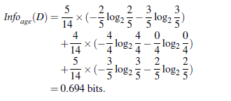
Attribute Selection: Information Gain

Slide 85
Attribute Selection: Information Gain

Slide 86
Attribute Selection: Information Gain

Slide 87
Attribute Selection: Information Gain

Slide 88
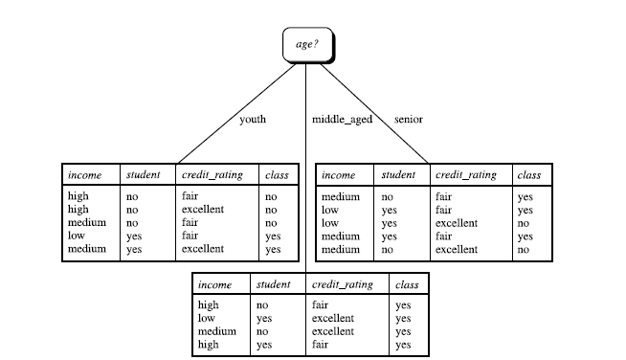
The attribute age has the highest information gain and therefore becomes the splitting attribute at the root node of the decision tree. Branches are grown for each outcome of age. The tuples are shown partitioned accordingly.
Here the all data set middle_aged has similar class label “yes” hence it become leaf node labelled with buys computer=“yes” and data subsets youth and senior have different class label yes and no hence apply same algorithm for both data subsets repeatedly until unless it converted into leaf node i.e. all tuple has same class label.

Slide 89
Buys_omputer
=
“yes”

Slide 90
youth partition D1
income | student | credit_rating | buys_computer
high | no | fair | no
high | no | excellent | no
medium | yes | excellent | yes
medium | no | fair | no
low | yes | fair | yes
Gain(income)=0.970-0.40=0.570
Gain(student)=0.970-0.00=0.970 →has highest information gain(split point)
Gain(credit_rating)=0.970-0.584=0.387

Slide 91
After splitting partition D1 tree is ?
age?
youth
middle_aged
senior
student?
Buys computer
“yes”
no
yes
income | credit_rating | buys_computer
high | fair | no
high | excellent | no
medium | fair | no
income | credit_rating | buys_computer
medium | excellent | yes
low | fair | yes
Converted into leaf node “no”
Converted into leaf node “yes”

Slide 92
After splitting partition D1 tree is ?
age?
youth
senior
middle_aged
student?
Buys computer
“yes”
no
yes
Buys computer
“no”
Buys computer
“yes”

Slide 93
Senior age partition D2
income | student | credit_rating | buys_computer
medium | no | excellent | no
medium | no | fair | yes
low | yes | fair | yes
low | yes | excellent | no
medium | yes | fair | yes
Gain(income)=0.970-0.40=0.570
Gain(credit rating)=0.970-0.00=0.970 →has highest information gain(split point)
Gain(student)=0.970-0.40=0.570

Slide 94
After splitting partition D2 tree is ?
age?
youth
middle_aged
senior
student?
Buys computer
“yes”
Credit_rating?
no
yes
Excellent
fair
Buys computer
“no”
Buys computer
“yes”
income | student | buys_computer
low | yes | no
Medium | no | no
income | student | buys_computer
medium | no | yes
low | yes | yes
Medium | yes | yes
Converted into leaf node “yes”
Converted into leaf node “no”

Slide 95
Final Decision tree ?
age?
youth
middle_aged
senior
Buys computer
“Yes”
student?
credit rating?
no
yes
excellent
fair
Buys computer
“No”
Buys computer
“Yes”
Buys computer
“No”
Buys computer
“Yes”
Data to be classified:
X = (age=youth, Income = medium, Student = yes, credit_rating = Fair)
Class of Data X is Buys computer=YES

Slide 96
Computing Information-Gain for Continuous-Valued Attributes
Let attribute A be a continuous-valued attribute
Must determine the best split point for A
Sort the value A in increasing order
Typically, the midpoint between each pair of adjacent values is considered as a possible split point
(a_{i}+a_{i+1})/2 is the midpoint between the values of a_{i} and a_{i+1}
The point with the minimum expected information requirement for A is selected as the split-point for A
Split:
D1 is the set of tuples in D satisfying A ≤ split-point, and D2 is the set of tuples in D satisfying A > split-point

Slide 97
Gain Ratio for Attribute Selection (C4.5)
Information gain measure is biased towards attributes with a large number of values
C4.5 (a successor of ID3) uses gain ratio to overcome the problem (normalization to information gain)
GainRatio(A) = Gain(A)/SplitInfo(A)
Ex.
gain_ratio(income) = 0.029/1.557 = 0.019
The attribute with the maximum gain ratio is selected as the splitting attribute

Slide 98
Gini Index (CART, IBM IntelligentMiner)
If a data set D contains examples from n classes, gini index, gini(D) is defined as
where p_{j} is the relative frequency of class j in D
If a data set D is split on A into two subsets D₁ and D₂, the gini index gini(D) is defined as
Reduction in Impurity:
The attribute provides the smallest gini_{split}(D) (or the largest reduction in impurity) is chosen to split the node (need to enumerate all the possible splitting points for each attribute)

Slide 99
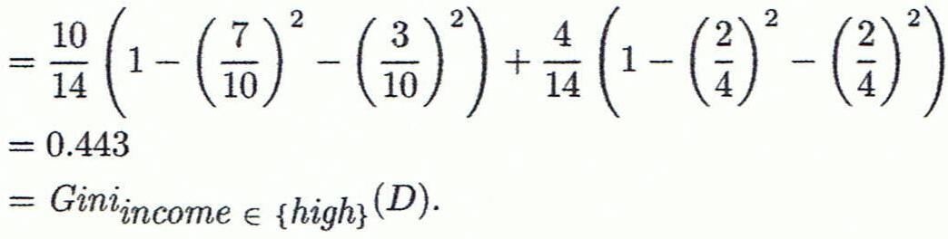
Computation of Gini Index
Ex. D has 9 tuples in buys_computer = “yes” and 5 in “no”
Suppose the attribute income partitions D into 10 in D₁: {low, medium} and 4 in D₂
Gini_{{low,high}} is 0.458; Gini_{{medium,high}} is 0.450. Thus, split on the {low,medium} (and {high}) since it has the lowest Gini index
All attributes are assumed continuous-valued
May need other tools, e.g., clustering, to get the possible split values
Can be modified for categorical attributes

Slide 100
Comparing Attribute Selection Measures
The three measures, in general, return good results but
Information gain:
biased towards multivalued attributes
Gain ratio:
tends to prefer unbalanced splits in which one partition is much smaller than the others
Gini index:
biased to multivalued attributes
has difficulty when # of classes is large
tends to favor tests that result in equal-sized partitions and purity in both partitions

Slide 101
Other Attribute Selection Measures
CHAID: a popular decision tree algorithm, measure based on χ² test for independence
C-SEP: performs better than info. gain and gini index in certain cases
G-statistic: has a close approximation to χ² distribution
MDL (Minimal Description Length) principle (i.e., the simplest solution is preferred):
The best tree as the one that requires the fewest # of bits to both (1) encode the tree, and (2) encode the exceptions to the tree
Multivariate splits (partition based on multiple variable combinations)
CART: finds multivariate splits based on a linear comb. of attrs.
Which attribute selection measure is the best?
Most give good results, none is significantly superior than others

Slide 102
Over fitting and Tree Pruning
Overfitting: An induced tree may overfit the training data
Too many branches, some may reflect anomalies due to noise or outliers
Poor accuracy for unseen samples
Two approaches to avoid overfitting
Prepruning: Halt tree construction early ̵ do not split a node if this would result in the goodness measure falling below a threshold
Difficult to choose an appropriate threshold
Postpruning: Remove branches from a “fully grown” tree—get a sequence of progressively pruned trees
Use a set of data different from the training data to decide which is the “best pruned tree”

Slide 103
Enhancements to Basic Decision Tree Induction
Allow for continuous-valued attributes
Dynamically define new discrete-valued attributes that partition the continuous attribute value into a discrete set of intervals
Handle missing attribute values
Assign the most common value of the attribute
Assign probability to each of the possible values
Attribute construction
Create new attributes based on existing ones that are sparsely represented
This reduces fragmentation, repetition, and replication

Slide 104
Classification in Large Databases
Classification—a classical problem extensively studied by statisticians and machine learning researchers
Scalability: Classifying data sets with millions of examples and hundreds of attributes with reasonable speed
Why is decision tree induction popular?
relatively faster learning speed (than other classification methods)
convertible to simple and easy to understand classification rules
can use SQL queries for accessing databases
comparable classification accuracy with other methods
RainForest (VLDB’98 — Gehrke, Ramakrishnan & Ganti)
Builds an AVC-list (attribute, value, class label)

Slide 105
Scalability Framework for RainForest
Separates the scalability aspects from the criteria that determine the quality of the tree
Builds an AVC-list: AVC (Attribute, Value, Class_label)
AVC-set (of an attribute X )
Projection of training dataset onto the attribute X and class label where counts of individual class label are aggregated
AVC-group (of a node n )
Set of AVC-sets of all predictor attributes at the node n

Slide 106
Rainforest: Training Set and Its AVC Sets
Training Examples
AVC-set on Age
AVC-set on income
Age | Buy_Computer
 | yes | no
<=30 | 2 | 3
31..40 | 4 | 0
>40 | 3 | 2
income | Buy_Computer
 | yes | no
high | 2 | 2
medium | 4 | 2
low | 3 | 1
AVC-set on
credit_rating
AVC-set on Student
student | Buy_Computer
 | yes | no
yes | 6 | 1
no | 3 | 4
Credit rating | Buy_Computer
 | yes | no
fair | 6 | 2
excellent | 3 | 3

Slide 107
Using IF-THEN Rules for Classification
Represent the knowledge in the form of IF-THEN rules
R: IF age = youth AND student = yes THEN buys_computer = yes
Rule antecedent/precondition vs. rule consequent
Assessment of a rule: coverage and accuracy
n_{covers} = # of tuples covered by R
n_{correct} = # of tuples correctly classified by R
coverage(R) = n_{covers} /|D| /* D: training data set */
accuracy(R) = n_{correct} / n_{covers}
If more than one rule are triggered, need conflict resolution
Size ordering: assign the highest priority to the triggering rules that has the “toughest” requirement (i.e., with the most attribute tests)
Class-based ordering: decreasing order of prevalence or misclassification cost per class
Rule-based ordering (decision list): rules are organized into one long priority list, according to some measure of rule quality or by experts

Slide 108
Rule Extraction from a Decision Tree
Rules are easier to understand than large trees
One rule is created for each path from the root to a leaf
Each attribute-value pair along a path forms a conjunction: the leaf holds the class prediction
Rules are mutually exclusive and exhaustive
age?
<=30
31..40
>40
student?
yes
credit rating?
no
yes
excellent
fair
no
yes
no
yes
Example: Rule extraction from our buys_computer decision-tree
IF age = young AND student = no THEN buys_computer = no
IF age = young AND student = yes THEN buys_computer = yes
IF age = mid-age THEN buys_computer = yes
IF age = old AND credit_rating = excellent THEN buys_computer = no
IF age = old AND credit_rating = fair THEN buys_computer = yes

Slide 109
Rule Induction: Sequential Covering Method
Sequential covering algorithm: Extracts rules directly from training data
Typical sequential covering algorithms: FOIL, AQ, CN2, RIPPER
Rules are learned sequentially, each for a given class C_{i} will cover many tuples of C_{i} but none (or few) of the tuples of other classes
Steps:
Rules are learned one at a time
Each time a rule is learned, the tuples covered by the rules are removed
Repeat the process on the remaining tuples until termination condition, e.g., when no more training examples or when the quality of a rule returned is below a user-specified threshold
Comp. w. decision-tree induction: learning a set of rules simultaneously

Slide 110
Sequential Covering Algorithm
while (enough target tuples left)
generate a rule
remove positive target tuples satisfying this rule
Examples covered
by Rule 2
Examples covered
by Rule 1
Examples covered
by Rule 3
Positive examples

Slide 111
Rule Generation
To generate a rule
while(true)
find the best predicate p
if foil-gain(p) > threshold then add p to current rule
else break
A3=1
A3=1&&A1=2
A3=1&&A1=2
&&A8=5
Positive examples
Negative examples

Slide 112
How to Learn-One-Rule?
Start with the most general rule possible: condition = empty
Adding new attributes by adopting a greedy depth-first strategy
Picks the one that most improves the rule quality
Rule-Quality measures: consider both coverage and accuracy
Foil-gain (in FOIL & RIPPER): assesses info_gain by extending condition
favors rules that have high accuracy and cover many positive tuples
Rule pruning based on an independent set of test tuples
Pos/neg are # of positive/negative tuples covered by R.
If FOIL_Prune is higher for the pruned version of R, prune R

Slide 113
Model Evaluation and Selection
Evaluation metrics: How can we measure accuracy? Other metrics to consider?
Use validation test set of class-labeled tuples instead of training set when assessing accuracy
Methods for estimating a classifier’s accuracy:
Holdout method, random subsampling
Cross-validation
Bootstrap
Comparing classifiers:
Confidence intervals
Cost-benefit analysis and ROC Curves
113

Slide 114
Classifier Evaluation Metrics: Confusion Matrix
Confusion Matrix:
Actual class\Predicted class | C₁ | ¬ C₁
C₁ | True Positives (TP) | False Negatives (FN)
¬ C₁ | False Positives (FP) | True Negatives (TN)
Example of Confusion Matrix:
Actual class\Predicted class | buy_computer = yes | buy_computer = no | Total
buy_computer = yes | 6954 | 46 | 7000
buy_computer = no | 412 | 2588 | 3000
Total | 7366 | 2634 | 10000
Given m classes, an entry, CM_{i,j} in a confusion matrix indicates # of tuples in class i that were labeled by the classifier as class j
May have extra rows/columns to provide totals
114

Slide 115
Classifier Evaluation Metrics: Accuracy, Error Rate, Sensitivity and Specificity
A\P | C | ¬C
C | TP | FN | P
¬C | FP | TN | N
 | P’ | N’ | All
Class Imbalance Problem:
One class may be rare, e.g. fraud, or HIV-positive
Significant majority of the negative class and minority of the positive class
Sensitivity: True Positive recognition rate
Sensitivity = TP/P
Specificity: True Negative recognition rate
Specificity = TN/N
Classifier Accuracy, or recognition rate: percentage of test set tuples that are correctly classified
Accuracy = (TP + TN)/All
Error rate: 1 – accuracy, or
Error rate = (FP + FN)/All
115

Slide 116
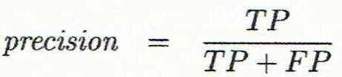
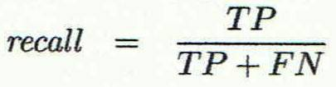
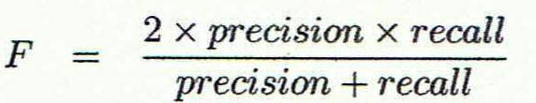
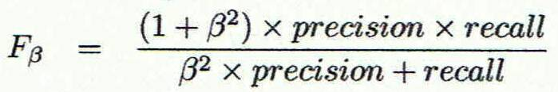
Classifier Evaluation Metrics: Precision and Recall, and F-measures
Precision: exactness – what % of tuples that the classifier labeled as positive are actually positive
Recall: completeness – what % of positive tuples did the classifier label as positive?
Perfect score is 1.0
Inverse relationship between precision & recall
F measure (F₁ or F-score): harmonic mean of precision and recall,
F_{ß}: weighted measure of precision and recall
assigns ß times as much weight to recall as to precision
116

Slide 117
Classifier Evaluation Metrics: Example
Actual Class\Predicted class | cancer = yes | cancer = no | Total | Recognition(%)
cancer = yes | 90 | 210 | 300 | 30.00 (sensitivity
cancer = no | 140 | 9560 | 9700 | 98.56 (specificity)
Total | 230 | 9770 | 10000 | 96.40 (accuracy)
Precision = 90/230 = 39.13% Recall = 90/300 = 30.00%
117

Slide 118
Evaluating Classifier Accuracy: Holdout & Cross-Validation Methods
Holdout method
Given data is randomly partitioned into two independent sets
Training set (e.g., 2/3) for model construction
Test set (e.g., 1/3) for accuracy estimation
Random sampling: a variation of holdout
Repeat holdout k times, accuracy = avg. of the accuracies obtained
Cross-validation (k-fold, where k = 10 is most popular)
Randomly partition the data into k mutually exclusive subsets, each approximately equal size
At i-th iteration, use D_{i} as test set and others as training set
Leave-one-out: k folds where k = # of tuples, for small sized data
*Stratified cross-validation*: folds are stratified so that class dist. in each fold is approx. the same as that in the initial data
118

Slide 119

Evaluating Classifier Accuracy: Bootstrap
Bootstrap
Works well with small data sets
Samples the given training tuples uniformly with replacement
i.e., each time a tuple is selected, it is equally likely to be selected again and re-added to the training set
Several bootstrap methods, and a common one is .632 boostrap
A data set with d tuples is sampled d times, with replacement, resulting in a training set of d samples. The data tuples that did not make it into the training set end up forming the test set. About 63.2% of the original data end up in the bootstrap, and the remaining 36.8% form the test set (since (1 – 1/d)^{d} ≈ e⁻¹ = 0.368)
Repeat the sampling procedure k times, overall accuracy of the model:
119

Slide 120


Estimating Confidence Intervals: Classifier Models M₁ vs. M₂
Suppose we have 2 classifiers, M₁ and M₂, which one is better?
Use 10-fold cross-validation to obtain and
These mean error rates are just estimates of error on the true population of future data cases
What if the difference between the 2 error rates is just attributed to chance?
Use a test of statistical significance
Obtain confidence limits for our error estimates
120

Slide 121
Estimating Confidence Intervals: Null Hypothesis
Perform 10-fold cross-validation
Assume samples follow a t distribution with k–1 degrees of freedom (here, k=10)
Use t-test (or Student’s t-test)
Null Hypothesis: M₁ & M₂ are the same
If we can reject null hypothesis, then
we conclude that the difference between M₁ & M₂ is statistically significant
Chose model with lower error rate
121

Slide 122
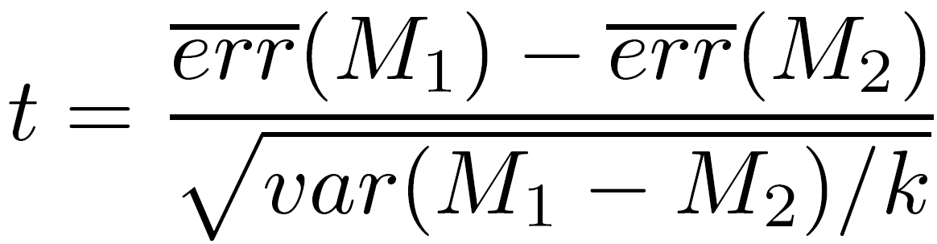
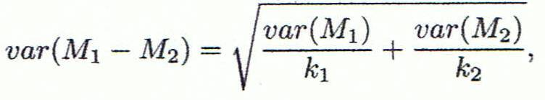
Estimating Confidence Intervals: t-test
If only 1 test set available: pairwise comparison
For i^{th} round of 10-fold cross-validation, the same cross partitioning is used to obtain err(M₁)_{i} and err(M₂)_{i}
Average over 10 rounds to get
t-test computes t-statistic with k-1 degrees of freedom:
If two test sets available: use non-paired t-test
and
where
where
where k₁ & k₂ are # of cross-validation samples used for M₁ & M₂, resp.
122

Slide 123
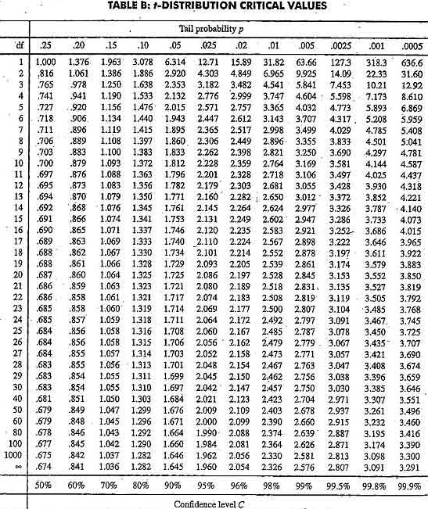
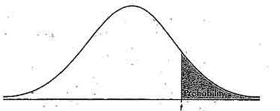
Estimating Confidence Intervals: Table for t-distribution
Symmetric
Significance level, e.g., sig = 0.05 or 5% means M₁ & M₂ are significantly different for 95% of population
Confidence limit, z = sig/2
123

Slide 124
Estimating Confidence Intervals: Statistical Significance
Are M₁ & M₂ significantly different?
Compute t. Select significance level (e.g. sig = 5%)
Consult table for t-distribution: Find t value corresponding to k-1 degrees of freedom (here, 9)
t-distribution is symmetric: typically upper % points of distribution shown → look up value for confidence limit z=sig/2 (here, 0.025)
If t > z or t < -z, then t value lies in rejection region:
Reject null hypothesis that mean error rates of M₁ & M₂ are same
Conclude: statistically significant difference between M₁ & M₂
Otherwise, conclude that any difference is chance
124

Slide 125
Model Selection: ROC Curves
ROC (Receiver Operating Characteristics) curves: for visual comparison of classification models
Originated from signal detection theory
Shows the trade-off between the true positive rate and the false positive rate
The area under the ROC curve is a measure of the accuracy of the model
Rank the test tuples in decreasing order: the one that is most likely to belong to the positive class appears at the top of the list
The closer to the diagonal line (i.e., the closer the area is to 0.5), the less accurate is the model
Vertical axis represents the true positive rate
Horizontal axis rep. the false positive rate
The plot also shows a diagonal line
A model with perfect accuracy will have an area of 1.0
125

Slide 126
Issues Affecting Model Selection
Accuracy
classifier accuracy: predicting class label
Speed
time to construct the model (training time)
time to use the model (classification/prediction time)
Robustness: handling noise and missing values
Scalability: efficiency in disk-resident databases
Interpretability
understanding and insight provided by the model
Other measures, e.g., goodness of rules, such as decision tree size or compactness of classification rules
126
Notes:
126

Slide 127
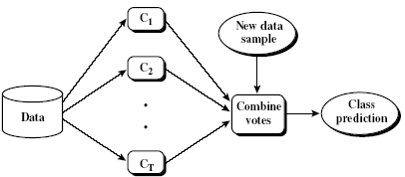
Ensemble Methods: Increasing the Accuracy
Ensemble methods
Use a combination of models to increase accuracy
Combine a series of k learned models, M₁, M₂, …, M_{k}, with the aim of creating an improved model M*
Popular ensemble methods
Bagging: averaging the prediction over a collection of classifiers
Boosting: weighted vote with a collection of classifiers
Ensemble: combining a set of heterogeneous classifiers
127

Slide 128
Bagging: Boostrap Aggregation
Analogy: Diagnosis based on multiple doctors’ majority vote
Training
Given a set D of d tuples, at each iteration i, a training set D_{i} of d tuples is sampled with replacement from D (i.e., bootstrap)
A classifier model M_{i} is learned for each training set D_{i}
Classification: classify an unknown sample X
Each classifier M_{i} returns its class prediction
The bagged classifier M* counts the votes and assigns the class with the most votes to X
Prediction: can be applied to the prediction of continuous values by taking the average value of each prediction for a given test tuple
Accuracy
Often significantly better than a single classifier derived from D
For noise data: not considerably worse, more robust
Proved improved accuracy in prediction
128

Slide 129
Boosting
Analogy: Consult several doctors, based on a combination of weighted diagnoses—weight assigned based on the previous diagnosis accuracy
How boosting works?
Weights are assigned to each training tuple
A series of k classifiers is iteratively learned
After a classifier M_{i} is learned, the weights are updated to allow the subsequent classifier, M_{i+1}, to pay more attention to the training tuples that were misclassified by M_{i}
The final M* combines the votes of each individual classifier, where the weight of each classifier's vote is a function of its accuracy
Boosting algorithm can be extended for numeric prediction
Comparing with bagging: Boosting tends to have greater accuracy, but it also risks overfitting the model to misclassified data
129

Slide 130
Adaboost (Freund and Schapire, 1997)
Given a set of d class-labeled tuples, (X₁, y₁), …, (X_{d}, y_{d})
Initially, all the weights of tuples are set the same (1/d)
Generate k classifiers in k rounds. At round i,
Tuples from D are sampled (with replacement) to form a training set D_{i} of the same size
Each tuple’s chance of being selected is based on its weight
A classification model M_{i} is derived from D_{i}
Its error rate is calculated using D_{i} as a test set
If a tuple is misclassified, its weight is increased, o.w. it is decreased
Error rate: err(X_{j}) is the misclassification error of tuple X_{j}. Classifier M_{i} error rate is the sum of the weights of the misclassified tuples:
The weight of classifier M_{i}’s vote is

Slide 131
Random Forest (Breiman 2001)
Random Forest:
Each classifier in the ensemble is a decision tree classifier and is generated using a random selection of attributes at each node to determine the split
During classification, each tree votes and the most popular class is returned
Two Methods to construct Random Forest:
Forest-RI (random input selection): Randomly select, at each node, F attributes as candidates for the split at the node. The CART methodology is used to grow the trees to maximum size
Forest-RC (random linear combinations): Creates new attributes (or features) that are a linear combination of the existing attributes (reduces the correlation between individual classifiers)
Comparable in accuracy to Adaboost, but more robust to errors and outliers
Insensitive to the number of attributes selected for consideration at each split, and faster than bagging or boosting
131

Slide 132
Classification of Class-Imbalanced Data Sets
Class-imbalance problem: Rare positive example but numerous negative ones, e.g., medical diagnosis, fraud, oil-spill, fault, etc.
Traditional methods assume a balanced distribution of classes and equal error costs: not suitable for class-imbalanced data
Typical methods for imbalance data in 2-class classification:
Oversampling: re-sampling of data from positive class
Under-sampling: randomly eliminate tuples from negative class
Threshold-moving: moves the decision threshold, t, so that the rare class tuples are easier to classify, and hence, less chance of costly false negative errors
Ensemble techniques: Ensemble multiple classifiers introduced above
Still difficult for class imbalance problem on multiclass tasks
132

Slide 133
Summary (I)
Classification is a form of data analysis that extracts models describing important data classes.
Effective and scalable methods have been developed for decision tree induction, Naive Bayesian classification, rule-based classification, and many other classification methods.
Evaluation metrics include: accuracy, sensitivity, specificity, precision, recall, F measure, and F_{ß} measure.
Stratified k-fold cross-validation is recommended for accuracy estimation. Bagging and boosting can be used to increase overall accuracy by learning and combining a series of individual models.
133

Slide 134
Summary (II)
Significance tests and ROC curves are useful for model selection.
There have been numerous comparisons of the different classification methods; the matter remains a research topic
No single method has been found to be superior over all others for all data sets
Issues such as accuracy, training time, robustness, scalability, and interpretability must be considered and can involve trade-offs, further complicating the quest for an overall superior method
134

Slide 135
References (1)
C. Apte and S. Weiss. Data mining with decision trees and decision rules. Future Generation Computer Systems, 13, 1997
C. M. Bishop, Neural Networks for Pattern Recognition. Oxford University Press, 1995
L. Breiman, J. Friedman, R. Olshen, and C. Stone. Classification and Regression Trees. Wadsworth International Group, 1984
C. J. C. Burges. A Tutorial on Support Vector Machines for Pattern Recognition. Data Mining and Knowledge Discovery, 2(2): 121-168, 1998
P. K. Chan and S. J. Stolfo. Learning arbiter and combiner trees from partitioned data for scaling machine learning. KDD'95
H. Cheng, X. Yan, J. Han, and C.-W. Hsu, Discriminative Frequent Pattern Analysis for Effective Classification, ICDE'07
H. Cheng, X. Yan, J. Han, and P. S. Yu, Direct Discriminative Pattern Mining for Effective Classification, ICDE'08
W. Cohen. Fast effective rule induction. ICML'95
G. Cong, K.-L. Tan, A. K. H. Tung, and X. Xu. Mining top-k covering rule groups for gene expression data. SIGMOD'05
135

Slide 136
Issues: Evaluating Classification Methods
Accuracy
classifier accuracy: predicting class label
predictor accuracy: guessing value of predicted attributes
Speed
time to construct the model (training time)
time to use the model (classification/prediction time)
Robustness: handling noise and missing values
Scalability: efficiency in disk-resident databases
Interpretability
understanding and insight provided by the model
Other measures, e.g., goodness of rules, such as decision tree size or compactness of classification rules
136
Notes:
136

Slide 137
Predictor Error Measures
Measure predictor accuracy: measure how far off the predicted value is from the actual known value
Loss function: measures the error betw. y_{i} and the predicted value y_{i}’
Absolute error: | y_{i} – y_{i}’|
Squared error: (y_{i} – y_{i}’)²
Test error (generalization error): the average loss over the test set
Mean absolute error: Mean squared error:
Relative absolute error: Relative squared error:
The mean squared-error exaggerates the presence of outliers
Popularly use (square) root mean-square error, similarly, root relative squared error
137
Notes:
137

Slide 138
Scalable Decision Tree Induction Methods
SLIQ (EDBT’96 — Mehta et al.)
Builds an index for each attribute and only class list and the current attribute list reside in memory
SPRINT (VLDB’96 — J. Shafer et al.)
Constructs an attribute list data structure
PUBLIC (VLDB’98 — Rastogi & Shim)
Integrates tree splitting and tree pruning: stop growing the tree earlier
RainForest (VLDB’98 — Gehrke, Ramakrishnan & Ganti)
Builds an AVC-list (attribute, value, class label)
BOAT (PODS’99 — Gehrke, Ganti, Ramakrishnan & Loh)
Uses bootstrapping to create several small samples
138
Notes:
138

Slide 139
Data Cube-Based Decision-Tree Induction
Integration of generalization with decision-tree induction (Kamber et al.’97)
Classification at primitive concept levels
E.g., precise temperature, humidity, outlook, etc.
Low-level concepts, scattered classes, bushy classification-trees
Semantic interpretation problems
Cube-based multi-level classification
Relevance analysis at multi-levels
Information-gain analysis with dimension + level
139
Notes:
139

